Slide 1
Automating Releases
Anne Ruskamp
March 21, 2015
Notes:
Who am I?
Software engineer at Beehive Industries
Lots of hats – server, builder, support, deployment, and sometimes I code
But what are we going to talk about today?

Slide 2

?
Notes:
But what are we going to talk about today?
The black box of what it takes to get the code / dev we do out the door to the rest of the world.
Hope that at the end of this talk you will be thinking more about your process and maybe get some ideas of new things to try

Slide 3
Overview
Why Care About Releases?
Context
Processes
Lessons Learned
Notes:
Why do we care about the black box?
“tell me what’cha working with” – our context
Makes the process and decisions made make more sense, and help you understand what may or may not make work in your context
Processes
Story time of how we went from manual to automated
Lessons Learned

Slide 4
Why Do We Care?
Engineers want to see their code used
Time spent on a release is time not working on new features
War Stories
High impact for customers
Notes:
Engineers want to see their code used
Who has written code they want to see used?
Seriously, what is the point if our code never sees the light of day?
Microsoft story about waterfall – employees would actually leave the company before actually seeing any of the work they did reaching consumers
Time factor
Time spent on releases (stabilization, hot fixes, coming in at 3am) is time we don’t get to work/time about new features / more interesting problems
Doug: we want to maximize our “makers” times
Everyone is a maker or a manager
War stories
Stress, war stories are cool later, but never at the time – because they are PAINFUL!
Some of ours:
AzureBackup tool & bacpacs
Inconsistent behavior in QA / Production (WOMM-ing)
At the office so late that I got lost driving home
Article on “best jobs” regarding stress vs pay
High impact for customers

Slide 5
How can we make our process…
Reliable
Repeatable
Visible
Efficient
Automated
Notes:
I said we were going to be talking about the black box / looking behind the curtain to a certain extent, so laying all my cards on the table: here’s what we and folks we have learned from have found to be the high-level components of building an awesome release process.
Now we don’t go around saying “now how can we make our process more _____?”
Rather its more often “I can’t believe the azure bacpac tool died again”
or “hey Anne, where is the release at again?”
or the QA guy saying “it worked on my machine – I specifically tested that – why isn’t it working in production?”
This is the punch line: How can we make our process:
+ Reliable
+ Repeatable
+ Visible
+ Efficient
Automated

Slide 6





Notes:
Context
NG
Venture capital + product dev
Take old guys with experience + new talent
Invest in the startup / software echo system in Nebraska

Slide 7
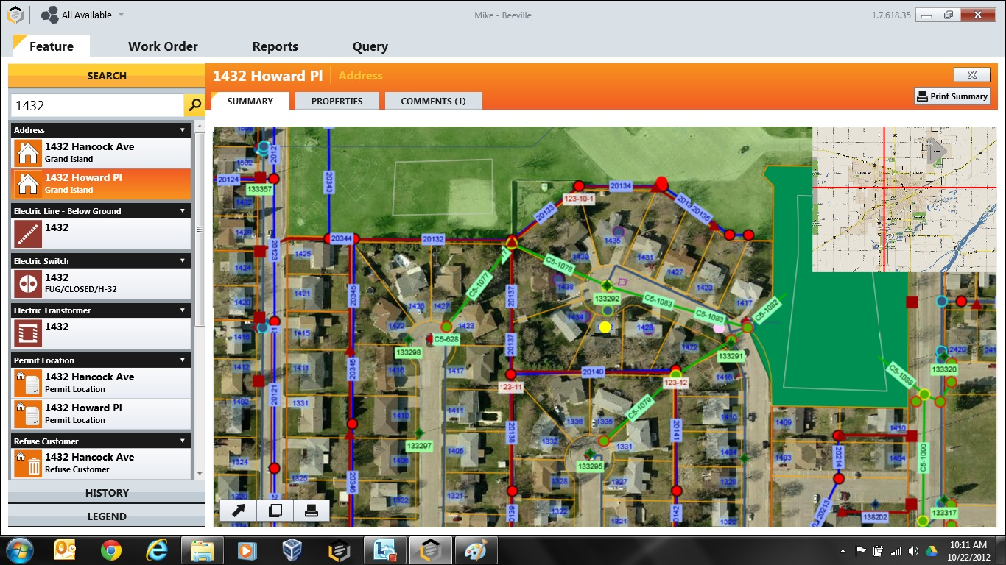
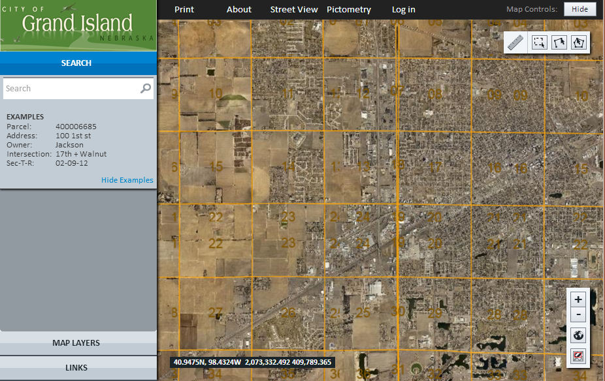
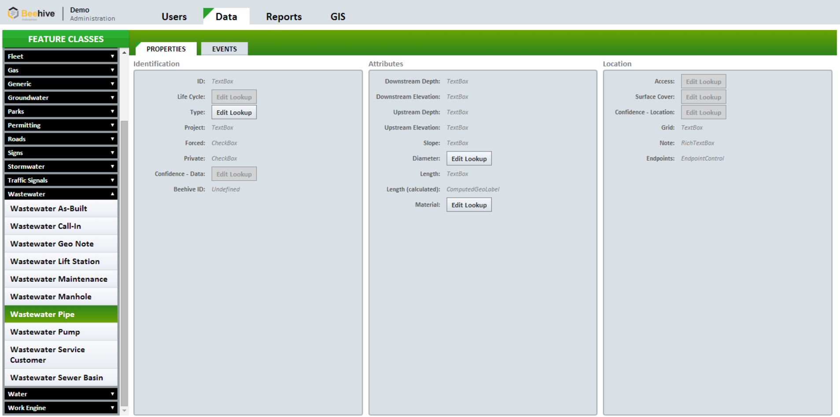
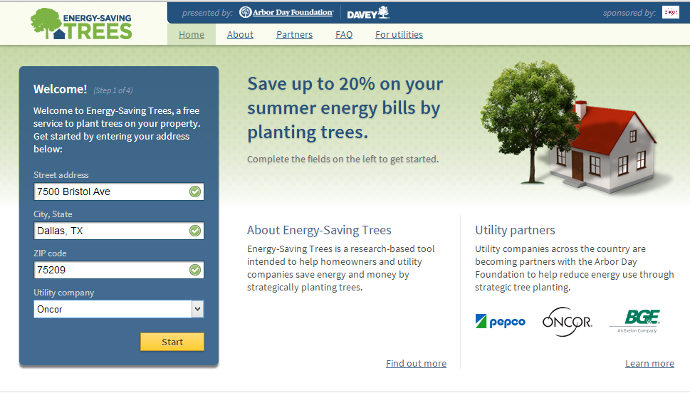
WPF
Websites
Notes:
Beehive
Company in the NG family
Platform with current primary use with
Small city government
Arbor Day
Fence

Slide 8
Beehive Services
Client Machine
Customer
DB
Customer DBs
WPF App
WCF Services
Sync
Pods
Server Instance
HTML 5 Homebase
Customer
DBs
Arbor Day
MySalesman
Notes:
Beehive hi-level architecture
Lots of clients
WPF and Web
Sync local data changes (but allows disconnected work)
Servers merge all clients changes through services

Slide 9
Beeville
Customer
Beeville
Hive-town
New Comb
Honey-ton
New Comb
Honey-ton
Hive-town
Service Version A
Service Version C
Service Version B
WPF App Version 1
WPF App Version 2
WPF App Version 3
HomeBase Version I
HomeBase Version II
Website Version III
Notes:
Requirements for our builds / release process
Each customer has its own database
Geo spatial indexes
Security related to customers have a local database of their data
Multi-version software: services and clients
A customer can use 1 or more clients
Each customer needs to be able to be on different versions

Slide 10
A long time ago in a galaxy far far away
Notes:
So what were we doing…? (A long time ago in a galaxy far far away)
Manual everything
Aka – the new girl does it…
Using red gate to write database scripts to run on our production server
Command line exe to do bacpacs of customers data
Copy new website bits to the servers
Copy service bits from staging server to master server

Slide 11
What & How…
Understand the problems / pain points
Quick wins first
Easy to do
Maximum impact
Notes:
What did we do about this? And how did we make this change?
Understand the problem / pain points
Manually released
Quick wins first
80/20 rule
Easy first
Maximum impact
Doing the bare minimum

Slide 12
Beeville
Customer | Version
Beeville | A
Hive-town | B
New Comb | C
Honey-ton | B
New Comb
Honey-ton
Hive-town
Service Version A
Service Version C
Service Version B
WPF App Version A
WPF App Version B
WPF App Version C
HomeBase Version A
HomeBase Version B
Website Version C
Notes:
Now we know that we can make some constraints/assumptions:
Requiring database, service, client version tie together
Makes it mentally easier
Force customers to get update (when they have an internet connection)
set-up this model up front
Now going to transition to process, but it is important to note here that this has happened over 3+ years – not overnight

Slide 13
Continuous Integration
“…is a development practice that requires developers to integrate code into a shared repository several times a day. Each check-in is then verified by an automated build, allowing teams to detect problems early.”
www.thoughtworks.com/continuous-integration
Notes:
Who has heard of CI?
Who is using CI?
Continuous integration
Not only CI, but Increasing the frequency of releases
Start with not only being painful, but let’s increase the pain and do it all the time (repeatability)
Practice makes perfect

Slide 14
Continuous Integration
Development
Source Control
Build Server
Compile
Test
Create Release Candidate
reports to
commits to
triggers

Slide 15

Builds
Zip and Ship
Build server with TeamCity
GitHub
Release
Dev
Run Unit Tests!
Notes:
Builds
Dev – run all our unit tests (reliable / visible – into status/quality)
Release – creates release candidates that are tested in QA and the same bits / scripts that are applied to productions when we decide
GitHub source control
Used to use tfs
Biggest pro: pull requests (or as we call them preqs)
Creates a natural code review, which is light-weight
Not process for process sake
Gets extra eyes on code before shipped
TeamCity
Has lots of build in capabilities for basic things - like compile my code
But also flexibility in the form of allowing you to run any script / exe you want
This is where we have written custom code to zip and ship the versions of each client and services

Slide 16
Continuous Integration – v2
…is a development practice that requires developers to integrate code and database changes into a shared repository several times a day. Each check-in is then verified by an automated build, allowing teams to detect problems early.
Notes:
Continuous Integration – new definition
Previously mentioned that one of the primary problems was manually writing db scripts (or generating via RedGate) to be run against a production server
Not reliable – uh… sort of self-explanatory, but “it was me!!!!”
Sort of repeatable (I ran the same scripts a lot of times to make sure they worked)
Not visible – I was the only one who saw the scripts prior to release
So thinking like an engineer and following patterns / practices that we used elsewhere, we applied the things that worked well from continuous integration to databases…
Now can even google notion of “database continuous integration”, which was not a term that was around (or one we had heard of when we started thinking about this issue)

Slide 17
Database Continuous Integration
Check-in database scripts to source control
Build Server
Runs scripts against test database
Saves off to be run when upgrading QA or production databases
Report when scripts can’t be run
Notes:
Database Continuous Integration
How does this work
Shout to Tony’s talk
Imitation is the greatest form of flattery
[[Let’s take a look behind the curtain at how this works… ]]
Take away from this:
There is no magic
There are probably nuances, which I am willing to discuss with folks latter
Devmes:
Added benefit that we weren’t trying to create, but now heavily rely upon
Downloads a database (from a nightly production backup)
Uses the same script engine
Dev machine is set-up and can quickly and easy jump between customers
Other pro: source control and history of our database

Slide 18
Release Process
Prep
Database update
Database checks
Application update
Email engineers
Notes:
Release Process
Wrote our own b/c we couldn’t find a tool that would do everything I need
Again, after we didn’t this manually a lot of times
Same releaser used from QA and production (reliable – hi-level of confidence of similar results)
Queue release from MC site (visibility)
Can watch release status from here
Emails at the end
Nightly rebuild of most (used to be all) customers from production – all automagical (efficient in terms of human effort / time)
Backup production database
Download on qa server
Drop previous qa database
Restore production database
Update app version for qa customer config
Queue release for all these qa customers

Slide 19
Database checks
Unit tests for our customer databases
Notes:
Database checks
Unit tests for customer database
NOT GOOD PRACTICE
We have to do this because of a biz prop that doesn’t allow us to have database constraints that a good relational database would have
Reliable / Visible / Efficient
Additional layer of QA + qa guy + unit testing + etc
Database integration tools out there
But this is code is so dead simple and we were already writing our own stuff so it was quicker to just do our own
[[ In fact, let’s just jump over look at the code…]
Any questions?

Slide 20
Throw Aways
Technology that didn’t meet our needs
Manual process
Notes:
Technology that doesn’t meet our needs
Azure database (old school)
Bacpacs
Not efficient – 10 minutes to maybe backup a database
Azure going down ☹
Manual
Computers are more reliable at repeating the same process over and over again
Didn’t have time to go into much today, but we have tried other processes and at times to automate too much (client side testing is very brittle) – AGAIN, none of this happened over-night
Take the quick easy wins first & see where it breaks

Slide 21
Keepers
Database Continuous Integration
DevMes: Fast Dev Machine Set-up
Mission Control & Emails
(Almost) Nightly Rebuild of QA
Unit Tests & Database Checks
Fire and Forget
Notes:
Database Continuous Integration
DevMes: fast machine set-ups
Visibility with Emails / MC
Nightly rebuilds of QA (repeatability / reliability)
Less issues with problems not showing up until we release to production
Unit tests and database checks
Less that a person manual check
Fire and forget
Releases are done with no one at the office
Emails at the end of the release still give visibility
Practiced a lot in qa (repeatability / reliability)
Reduce risk with releasing to production ~1 to 2 weeks (efficient)

Slide 22
How can YOU make our process…
Reliable
Repeatable
Visible
Efficient
Automated
Notes:
Think about your release process in terms of how can we make our process:
Reliable
Repeatable
Visible
Efficient
Automated

Slide 23
How to get ahold of me
E-mail: aruskamp@beehiveindustries.com
GitHub username: aneilsen
Twitter: @ennakey
Please fill out an eval: nebraskacode.com/Evals
Notes:
Questions

